Slide 1
Principal as lay ecclesial minister
Fr. Frank Donio, S.A.C., Catholic Apostolate Center
Dr. Barbara McGraw Edmondson, National Catholic
Educational Association

Slide 2
What does it mean to be a Lay Ecclesial Minister?

Slide 3
Church Documents

Slide 4
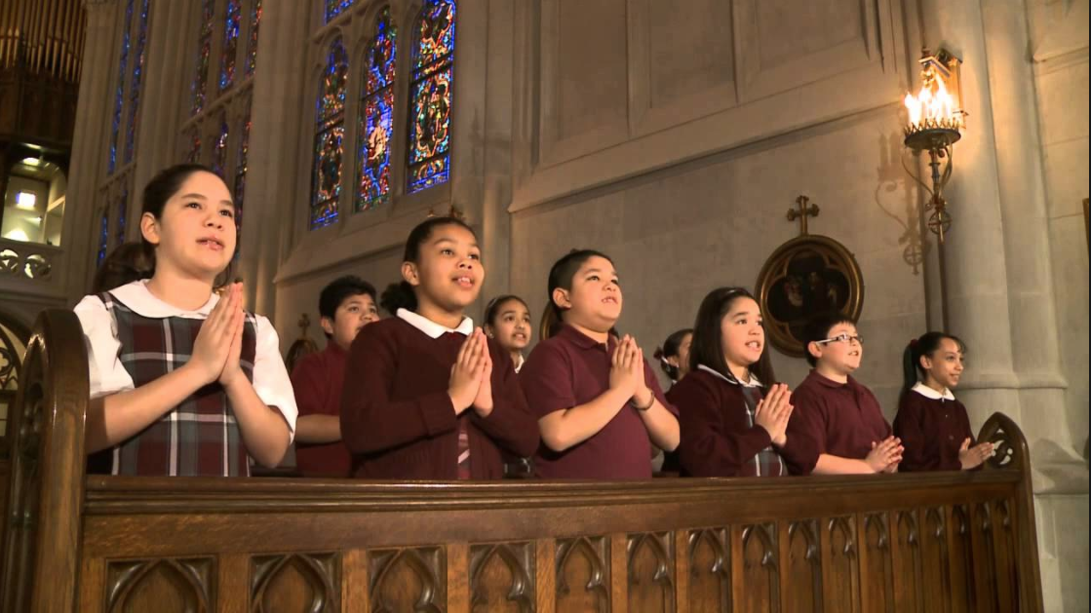
Role of the Principal
More than just Catholic identity

Slide 5
Defining Characteristics of a Catholic School Archbishop Michael Miller in The Holy See’s Teaching on Catholic Schools (2006).
Centered in the Person of Jesus Christ
Actively engaged in the evangelizing mission of the Church
Distinguished By Excellence
Committed to Educate the Whole Child
Steeped in a Catholic World view
Sustained by Gospel Witness
Steeped in Communion and Community
Accessible to all children
Established by the expressed authority of the Bishop

Slide 6
Role of the Principal
Welcome and hospitality
And delivering

Slide 7
Role of the Principal
Practical (simple)Ideas
Share your faith story
Acknowledge the Lord
Share a meal
Create prayer experiences

Slide 8
Formation of Faculty
“Community” vs.
“Family”

Slide 9
Questions?

