Slide 1
Using Social Media and Digital Resources to be Catholic Evangelical Witnesses
Fr. Frank Donio, S.A.C., D.Min.
Kate Fowler
Chris Pierno

Slide 2
Social Media
What platforms are you using?
How are you using those platforms?
What platforms do you want to expand to?

Slide 3
Introduction to Social Media Platforms

Slide 4
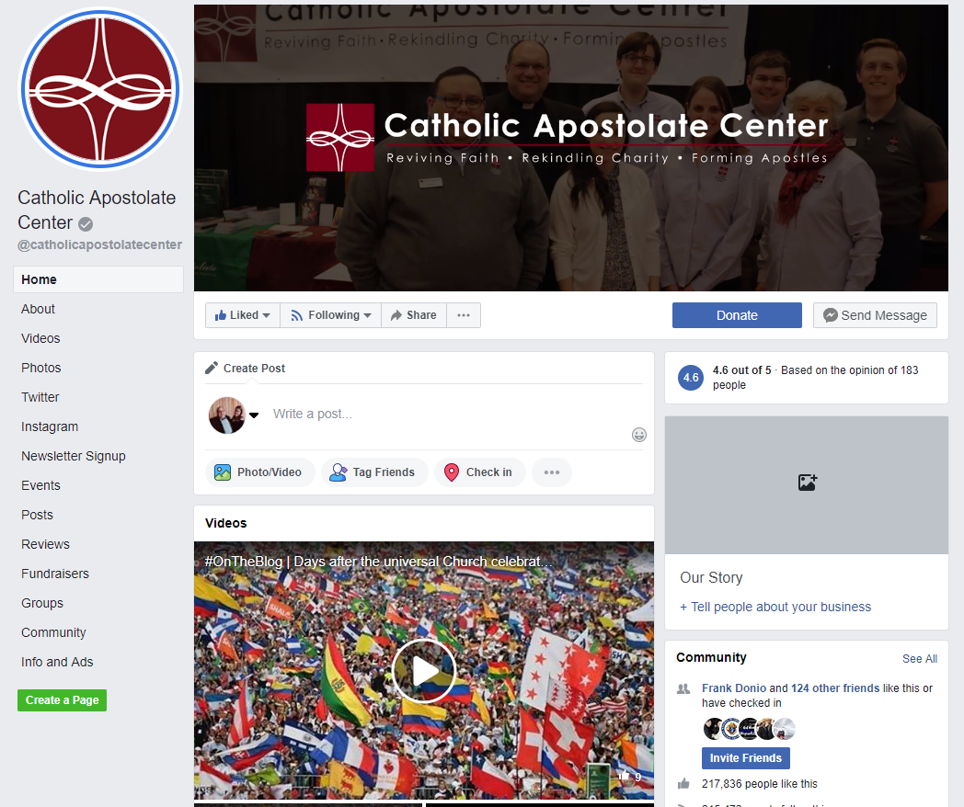
Facebook
Facebook by the numbers:
82 percent of 18 to 29-year-olds online in the U.S. use Facebook.
79 percent of 30 to 49-year-olds online in the U.S. use Facebook.
56 percent of U.S. online users ages 65 and up use Facebook.
Excellent for updates, events, photos, videos, longer content, directing audience to your website. Variety of post options. Great platform to start with.

Slide 5
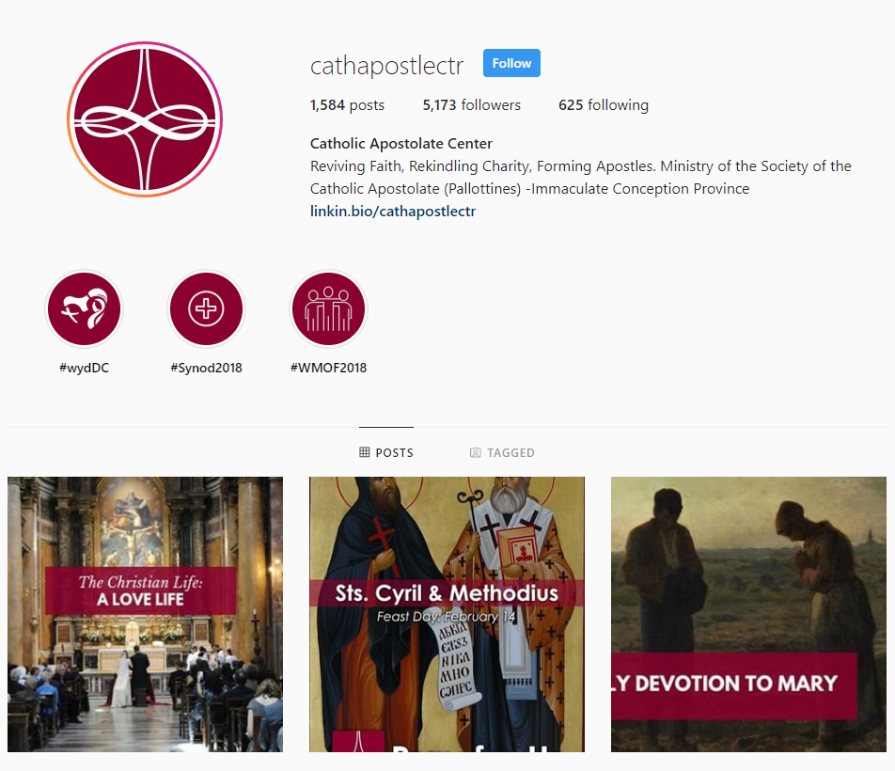
Instagram
Instagram by the numbers:
1 billion monthly active users
59% of internet users between the ages of 18 and 29 use Instagram and 33% of internet users between the ages of 30 and 49 use Instagram
72% of Teens use Instagram.
Photo-heavy platform – great for sharing about your events and work, connecting to younger audiences, can be linked directly to Facebook

Slide 6
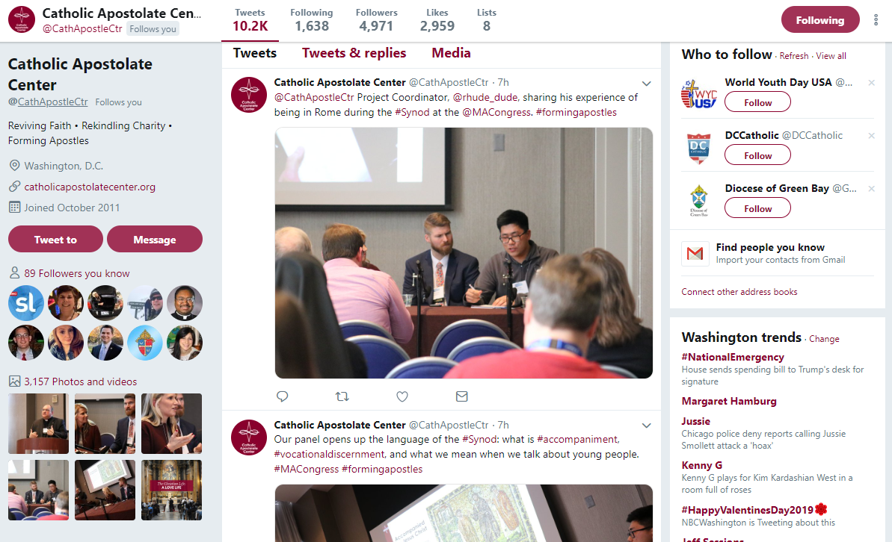
Twitter
Twitter by the numbers:
335 million active users
280 character limit per tweet
24% of U.S. adults use Twitter
Short Video, Polls, Images, GIFs
Excellent for sharing short updates, links to other articles, calls to action, live-feeds, #JointheConversation
#MACongress
#FormingApostles

Slide 7
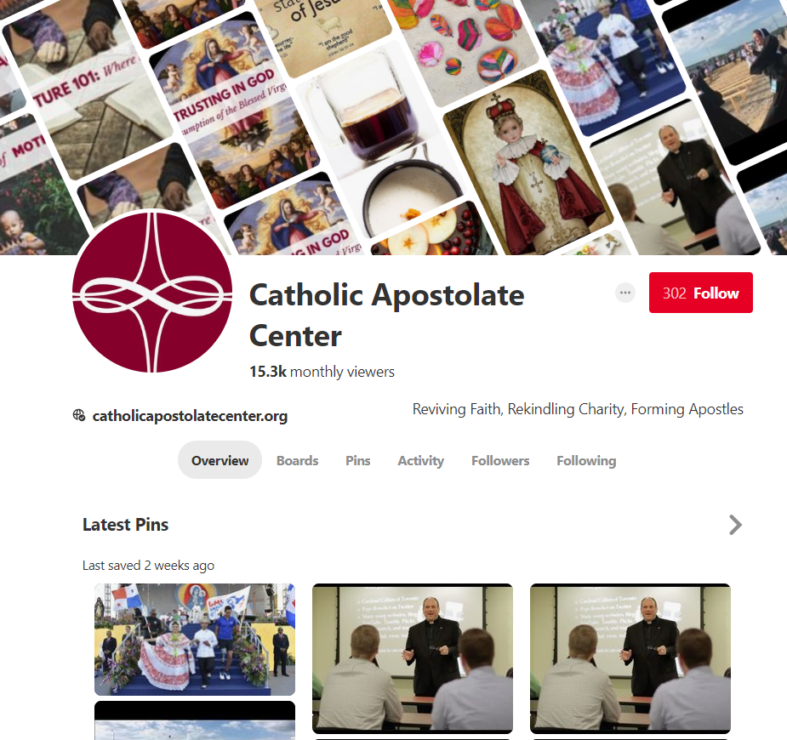
Pinterest
Pinterest users:
250 million monthly active users
“Catalogue of ideas" that inspires users to "go out and do that thing
29% of U.S. adults use Pinterest
Used to be heavily female
Excellent for keeping a log of ideas, organizing by theme

Slide 8
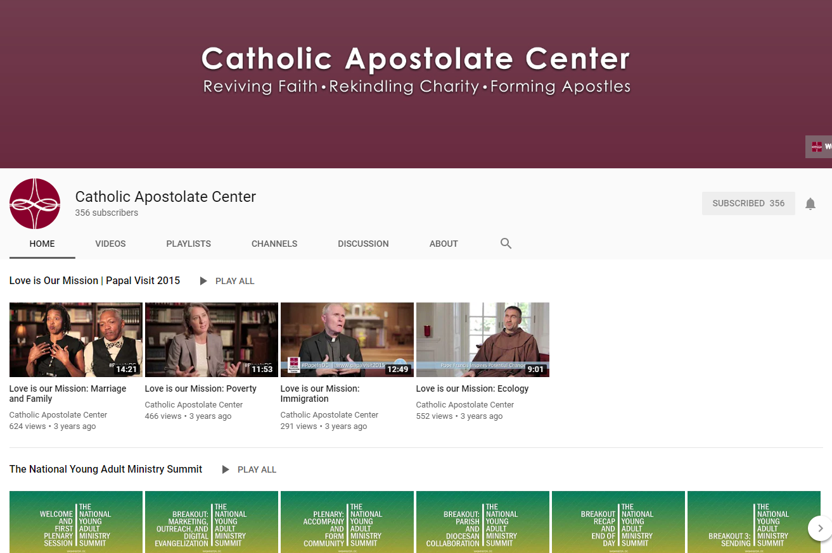
YouTube
YouTube by the numbers:
73% of US adults use YouTube
Grown from purely sharing personal videos to now featuring brands and corporate accounts
As of August 2018, the website is ranked as the second-most popular site in the world.
Excellent for posting videos from events, webinars, live streaming, lectures, Mass.

Slide 9
Introduction to Digital Resources and Emerging Platforms
Notes:
Social media usage is always impacted by new digital resources and emerging platforms. Digital resources are tools that help us use SM more effectively and engagingly. Emerging platforms are new social media platforms that we may want to consider using depending on our audience and who we want to reach.

Slide 10
Graphic-design tool website.
Drag-and-drop format with access to over a million photographs, graphics, and fonts.
Accessible and user-friendly: Used by non-designers and professionals.
Versatile tools used for both web and print media design and graphics.
Free resource with options for levels of membership.
Notes:
Canva is a free digital resource. See above.
Can pay for Canva for Work: brand kit, change dimensions of existing graphics, animated graphics, etc.

Slide 11
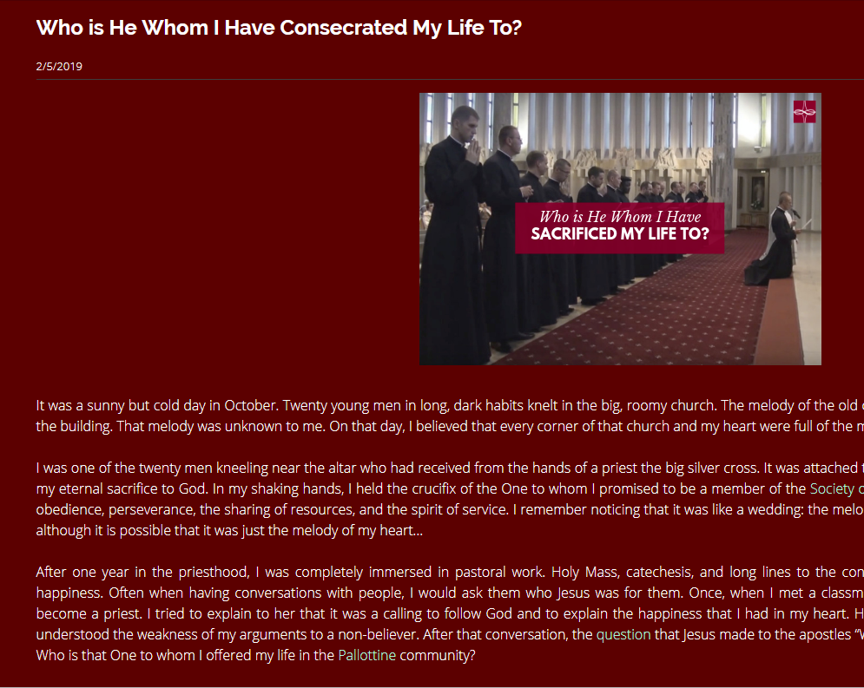
“Transform articles into videos in minutes.” –Lumen5
Notes:
Another digital resource. Helps you re-package existing content or easily make new content. Videos are much more engaging on SM. This is an easy and effective way to tap into audience interest in videos without spending too much time or spending tons of money.
Can have a free account up to a team account with various prices and feature differences.

Slide 12
“Instantly stream live to your friends and followers and interact with viewers in real time with Facebook Live. Live broadcasting made easy.” -Facebook
Notes:
Emerging tool on existing platform. Lets you broadcast live,

Slide 13
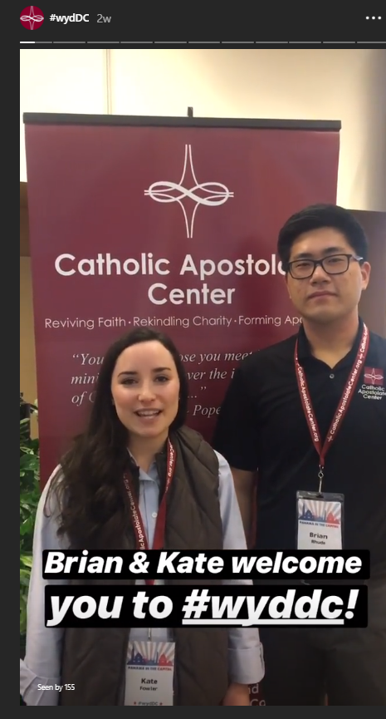
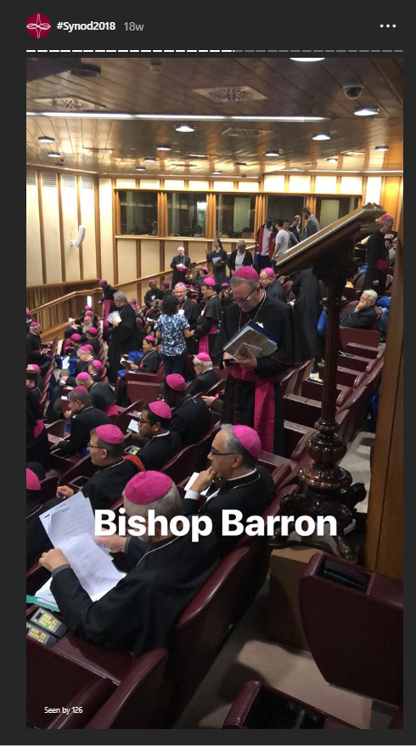
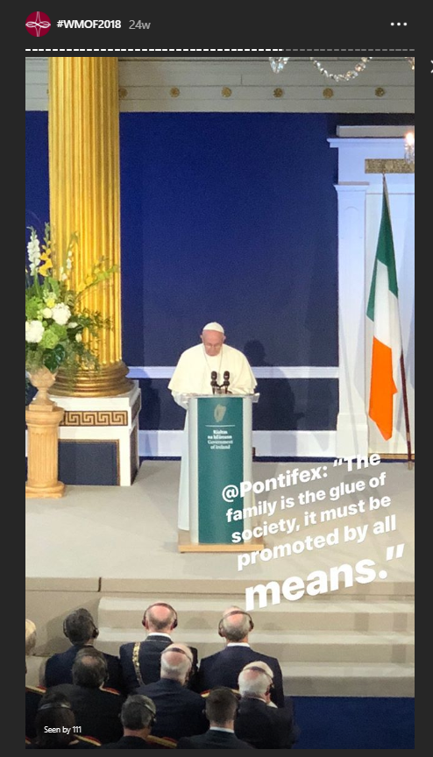
“Your story is a way of sharing photos and videos with your followers that disappear after 24 hours.” -Instagram
Notes:
Emerging tool on existing platform.

Slide 14
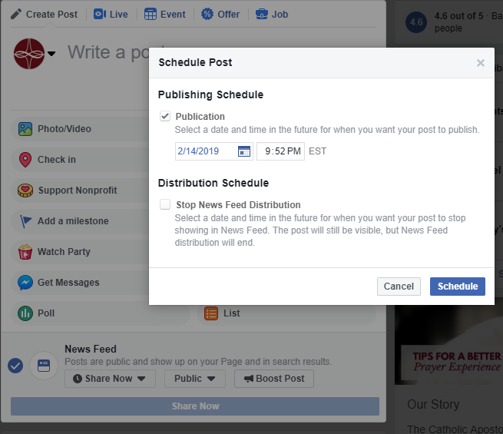
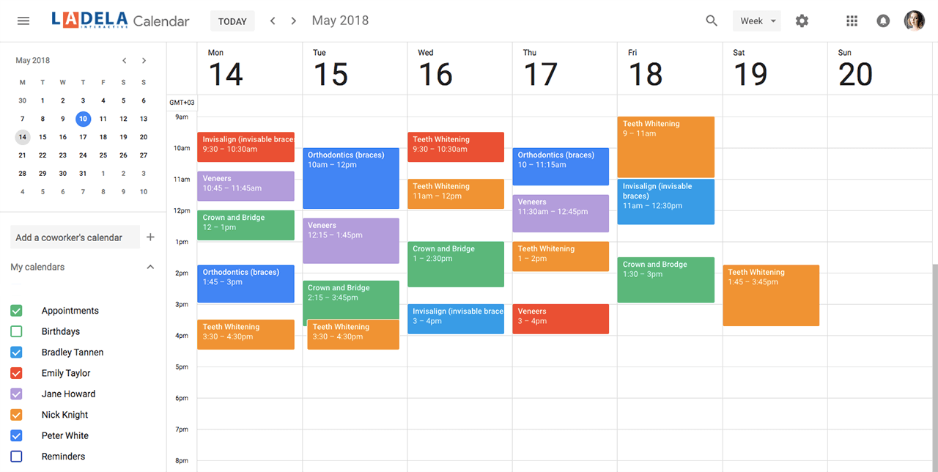
How do I manage all this?
Scheduling posts
Creating a Calendar
Enlisting some help

Slide 15
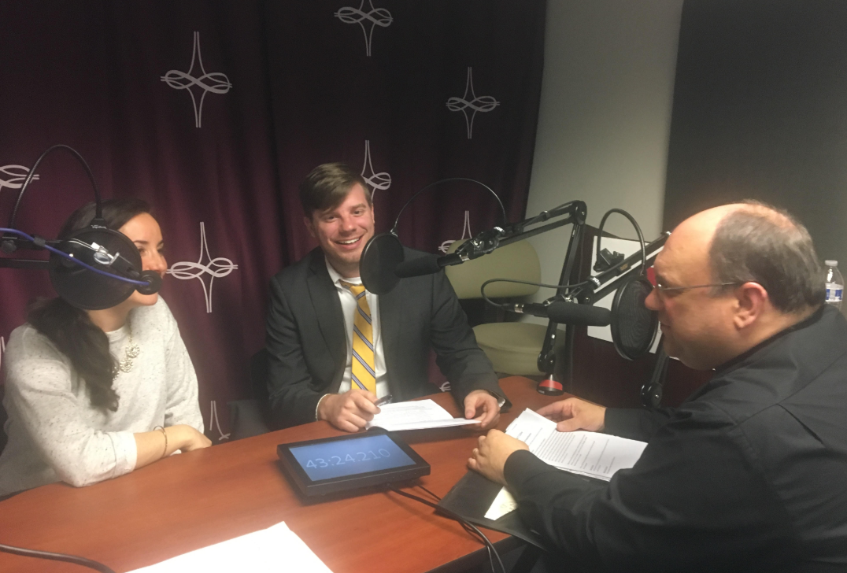
Is this something you want to invest in?
Do you have the content for regular updates?
You don’t have to be a big star.
CatholicApostolateCenter.org/Podcasts
Search “Catholic Apostolate Center”
on Apple Podcasts or Google Play

Slide 16
What to Keep in Mind
Review your content.
Maintain a consistent voice.
Remember your purpose.
Only handle as many platforms as you can.
Monitor your personal social media use.
Be charitable.

Slide 17
Open Conversation
Practical tips
How to use the platforms
Questions

Slide 18
Additional Resources
www.catholicapostolatecenter.org

