Slide 1
Collaborative Pastoral Planning
Fr. Frank Donio, S.A.C., Catholic Apostolate Center
Barbara Humphrey McCrabb, USCCB
Dr. Susan Timoney, archdiocese of Washington

Slide 2
Road Map for our session
Framework
Reflect on our Witness
Tools for Forming Missionary Disciples
Sending Forth
Notes:
Barbara

Slide 3
Defining the terms
What do we mean by:
Pastoral Planning?
Encounter?
Accompany?
Community?
Send?
Notes:
Fr. Frank

Slide 4
Encounter “Come and See” (Jn 1:46)
The purpose of evangelization is to lead people to encounter Christ. (page 9)
Notes:
Susan

Slide 5
Accompany “Follow me” (Mt 9:9)
The response to this encounter with Christ needs accompaniment. (page 14)
Notes:
Barbara

Slide 6
Community “Remain in me” (Jn 15:4)
Evangelization invites people to the Body of Christ, which is the Catholic Church. (page 16)
Notes:
Susan

Slide 7
Send “Go, therefore, and make disciples of all nations” (Mt 28:19)
Evangelization leads disciples to accept God’s desire to send them on mission.(page 17)
Notes:
Fr. Frank

Slide 8
Engagement
Greek to Me
Service
Growing the Parish
Missionary Discipleship
Notes:
Barbara

Slide 9
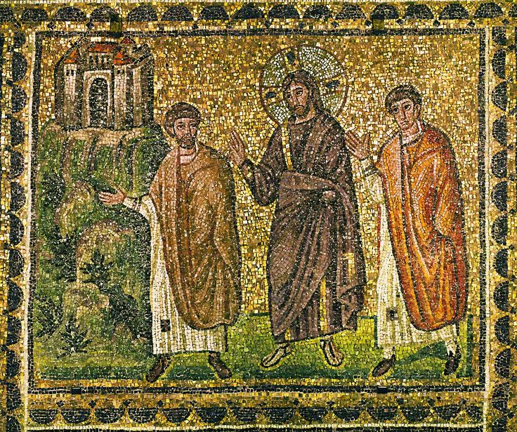
Encounter with Jesus Christ
“Jesus himself drew near and walked with them, but their eyes were prevented from recognizing him.”
(Luke 24:15-16)
Notes:
Fr. Frank

Slide 10
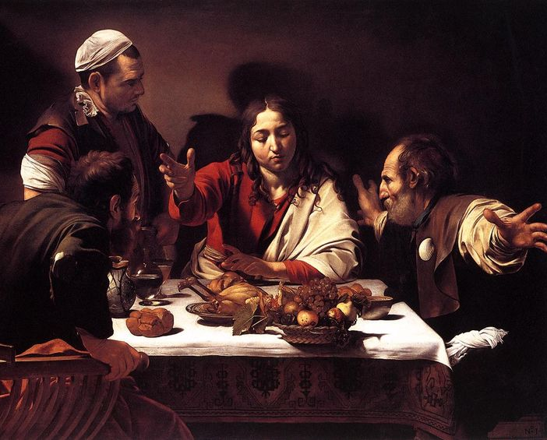
Encounter with Jesus Christ
Starting with self, then Assisting others
Reflect on and name an experience of encounter
Share with those around you
Notes:
Susan

Slide 11
Questions for Reflection
Do I have a relationship with Jesus Christ?
In what ways do I cultivate this friendship with Jesus and his Church?
How do I help others grow in their relationship with Christ and the Church?
What opportunities does the parish provide to cultivate ongoing encounters with Jesus?
Notes:
Barbara

Slide 12
Pastoral Plan for Missionary Discipleship
Six Dimensions to Consider
During a Pastoral Planning Process
Permeated with Prayer
Focused on Fruitfulness
Requires Leaders
Rooted in the Teachings of Our Faith and Supported by Foundational Pastoral Practices
Engages and Inspires People Through a Culture of Encounter and Accompaniment, Building Strong and Trusting Relationships
Requires Intentional Stewardship
Notes:
Fr. Frank

Slide 13
Permeated with Prayer
Notes:
Barbara

Slide 14
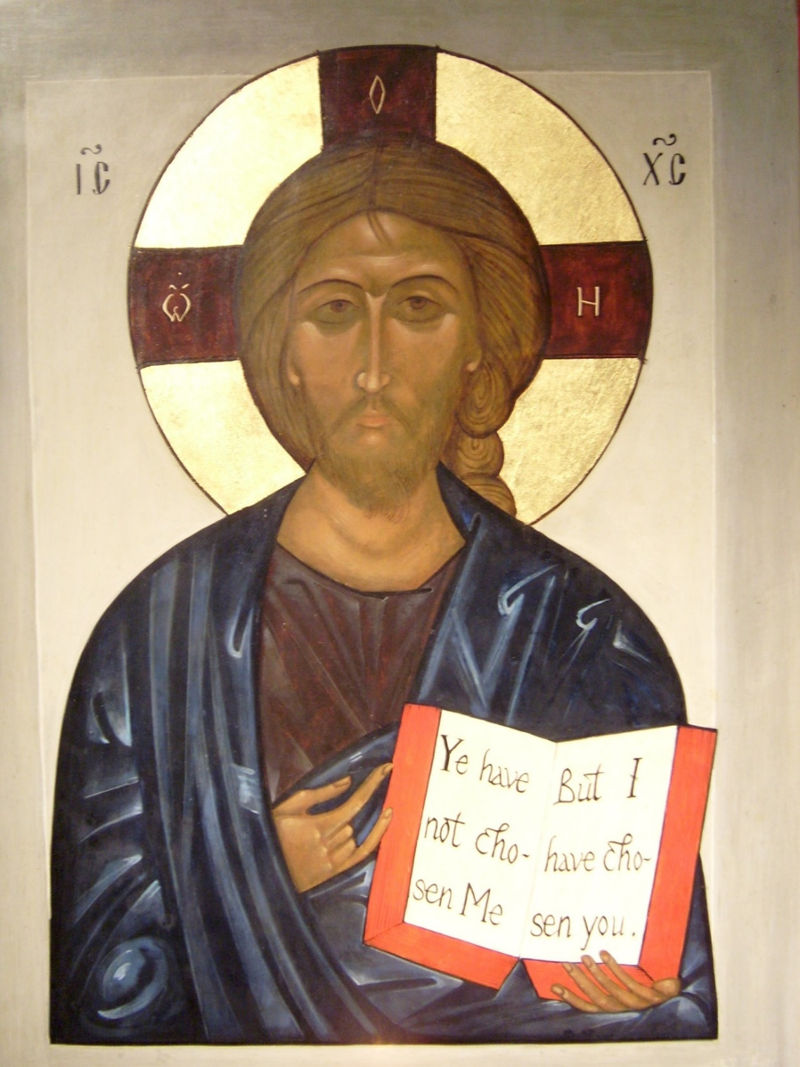
Focused on Fruitfulness
Notes:
Susan

Slide 15
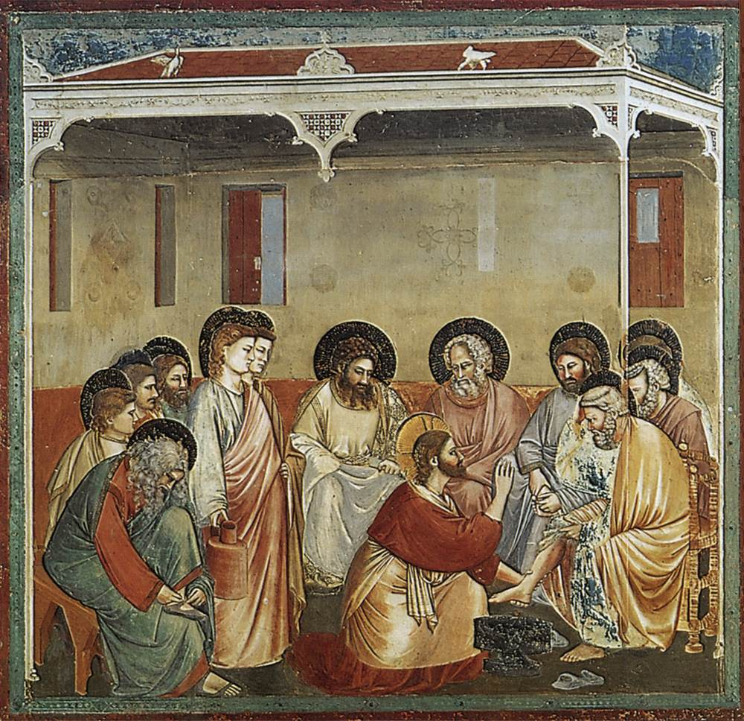
Requires Leaders
Pastoral Leaders Embrace:
Pastoral Formation
Spiritual Formation
Human Formation
Intellectual Formation
Pastoral Leaders are Interculturally Competent
Notes:
Fr. Frank

Slide 16
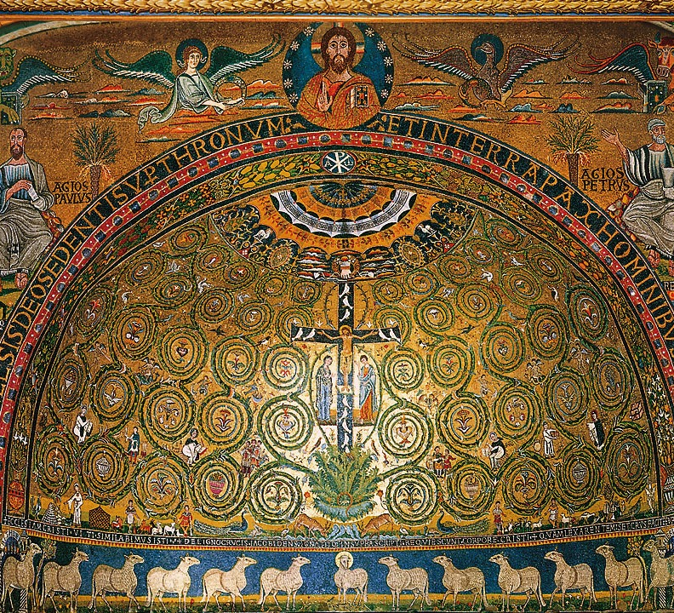
Rooted in the Teaching of our Faith and Supported by Foundational Pastoral Practices
Notes:
Susan

Slide 17
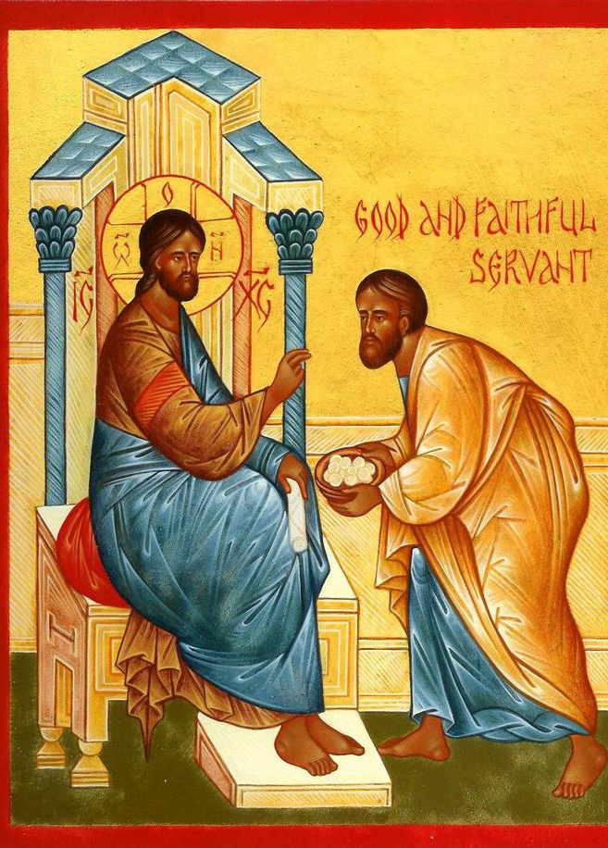
Requires Intentional Stewardship
Managing, Supervising, and Developing People
Sound Business Practices and Ethical Standards
Notes:
Barbara

Slide 18
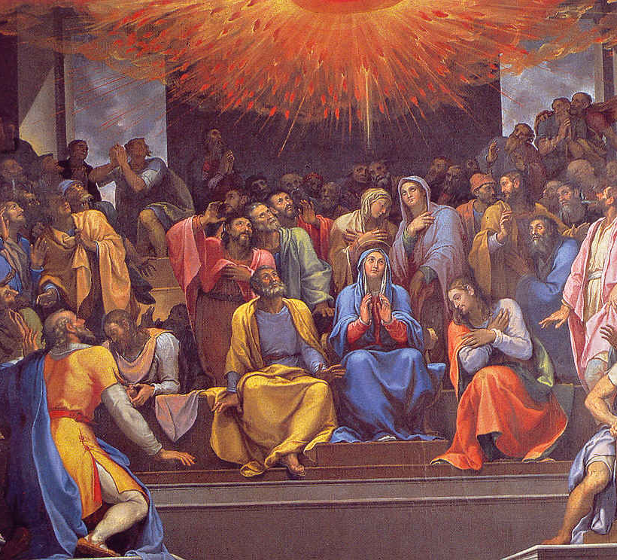
Engages and Inspires People Through a Culture of Encounter and Accompaniment, Building Strong and Trusting Relationships
Engaging Others Through Christian Witness in Everyday Life
Creating an Atmosphere of Invitation, Hospitality, and Trust
Building Collaborative Relationships, Teamwork, and Commitment
Welcoming and Embracing Ethnically Diverse Communities
Notes:
Fr. Frank

Slide 19
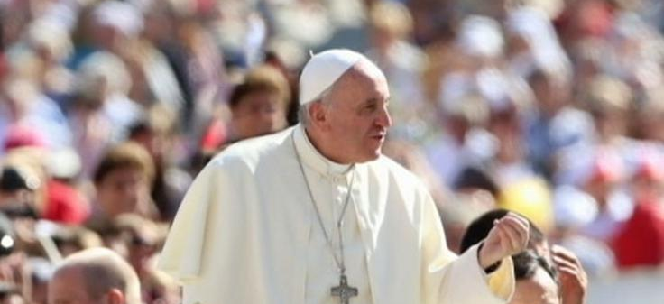
Co-Responsibility for the Mission of Christ and the Church
“Pastoral ministry in a missionary key seeks to abandon the complacent attitude that says: “We have always done it this way.”
I invite everyone to be bold and creative in this task of rethinking the goals, structures, style and methods of evangelization in their respective communities…
The important thing is to not walk alone, but to rely on each other as brothers and sisters, and especially under the leadership of the bishops, in a wise and realistic pastoral discernment.” (Evangelii Gaudium, 33)
Notes:
All

Slide 20
Questions?

