Slide 1
What Now? Vocational Discernment and Accompaniment After the 2018 Synod
Fr. Frank Donio, S.A.C, D.Min. – Catholic Apostolate Center
Jonathan Lewis – Archdiocese of Washington
Brian Rhude – Catholic Apostolate Center
Sarah Yaklic – Archdiocese of Los Angeles

Slide 2
What was the Synod?
Instituted by St. Paul VI in 1965 to continue the spirit of “collegiality” of the Second Vatican Council
15th Ordinary Synod Assembly: Young People, the Faith, and Vocational Discernment
Synod of Bishops (around 300 Bishops)
Inclusion of first person witnesses (around 30 young people)

Slide 3
What was the Synod?
Three Phases:
Preparatory Phase (Pre-Synodal meeting with 300 young people
Discussion Phase (Synod of Bishops, October 3-28)
Implementation Phase:
“to initiate the reception of the Synod’s conclusions in all the local Churches… the synodal process not only has its point of departure but also its point of arrival in the People of God, upon whom the gifts of grace bestowed by the Holy Spirit through the gathering of Bishops in Assembly must be poured out.” (Episcopalis Communio, 7)

Slide 4
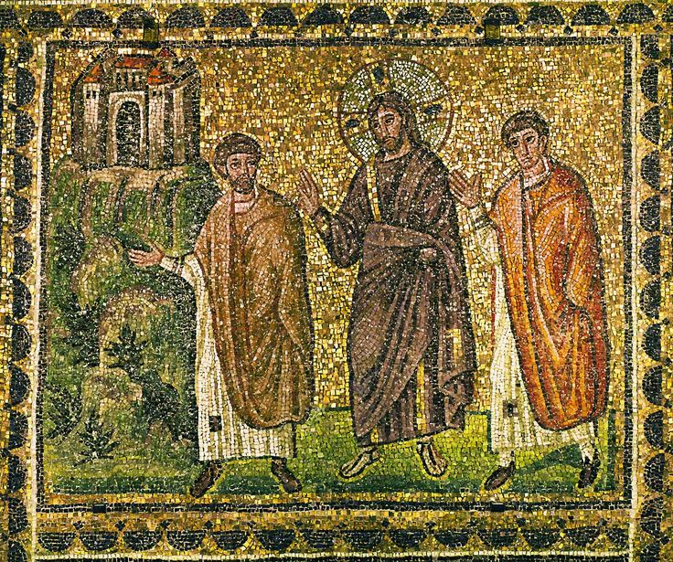
Accompanied by Jesus Christ
“Jesus himself drew near and walked with them, but their eyes were prevented from recognizing him.”
(Luke 24:15-16)

Slide 5
Vocational Discernment

Slide 6
Statistics on Young People

Slide 9
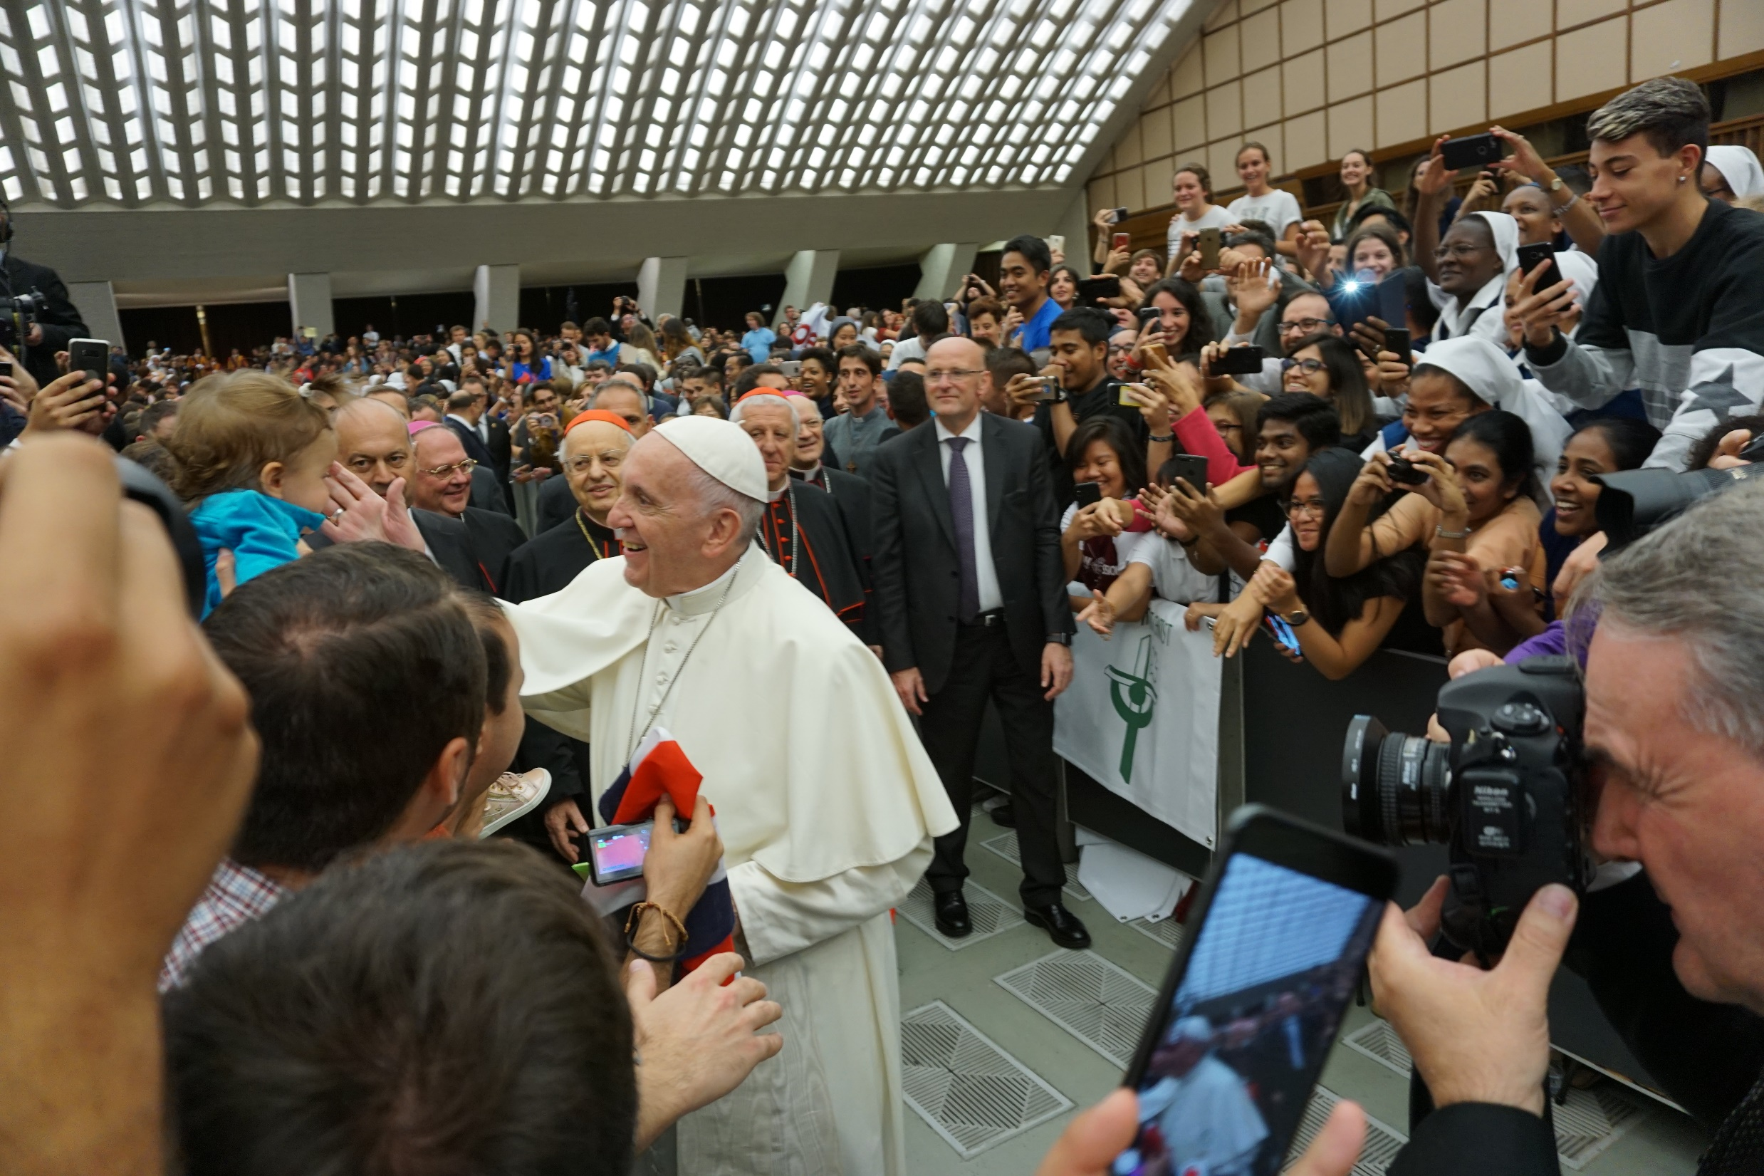

Slide 10
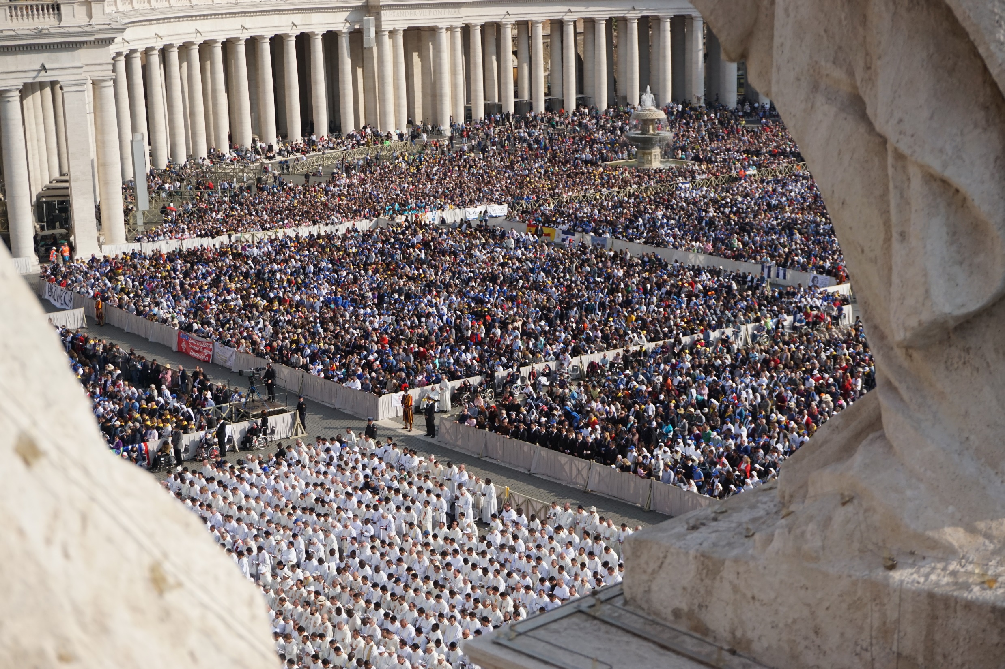

Slide 11
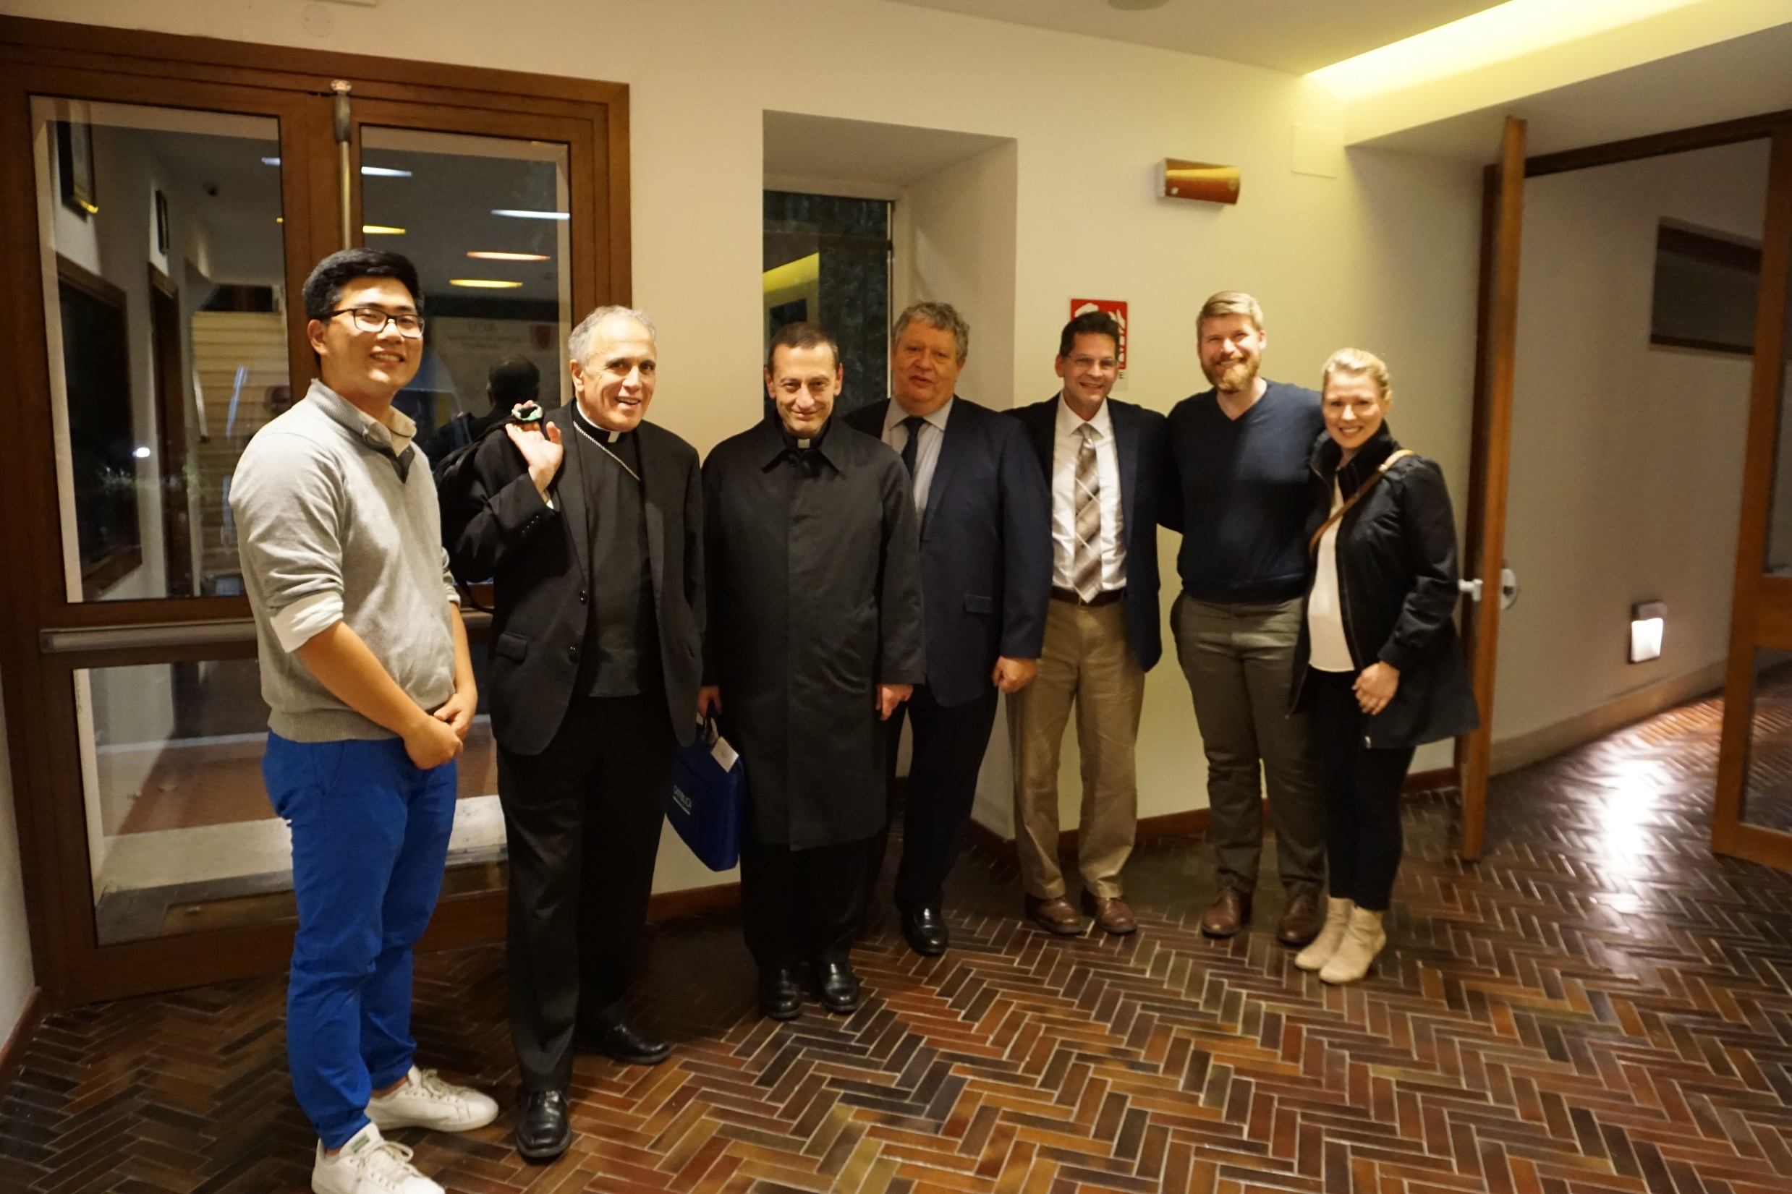

Slide 12
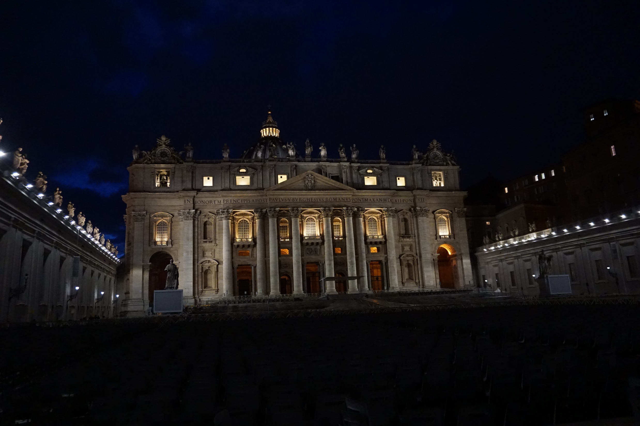

Slide 13
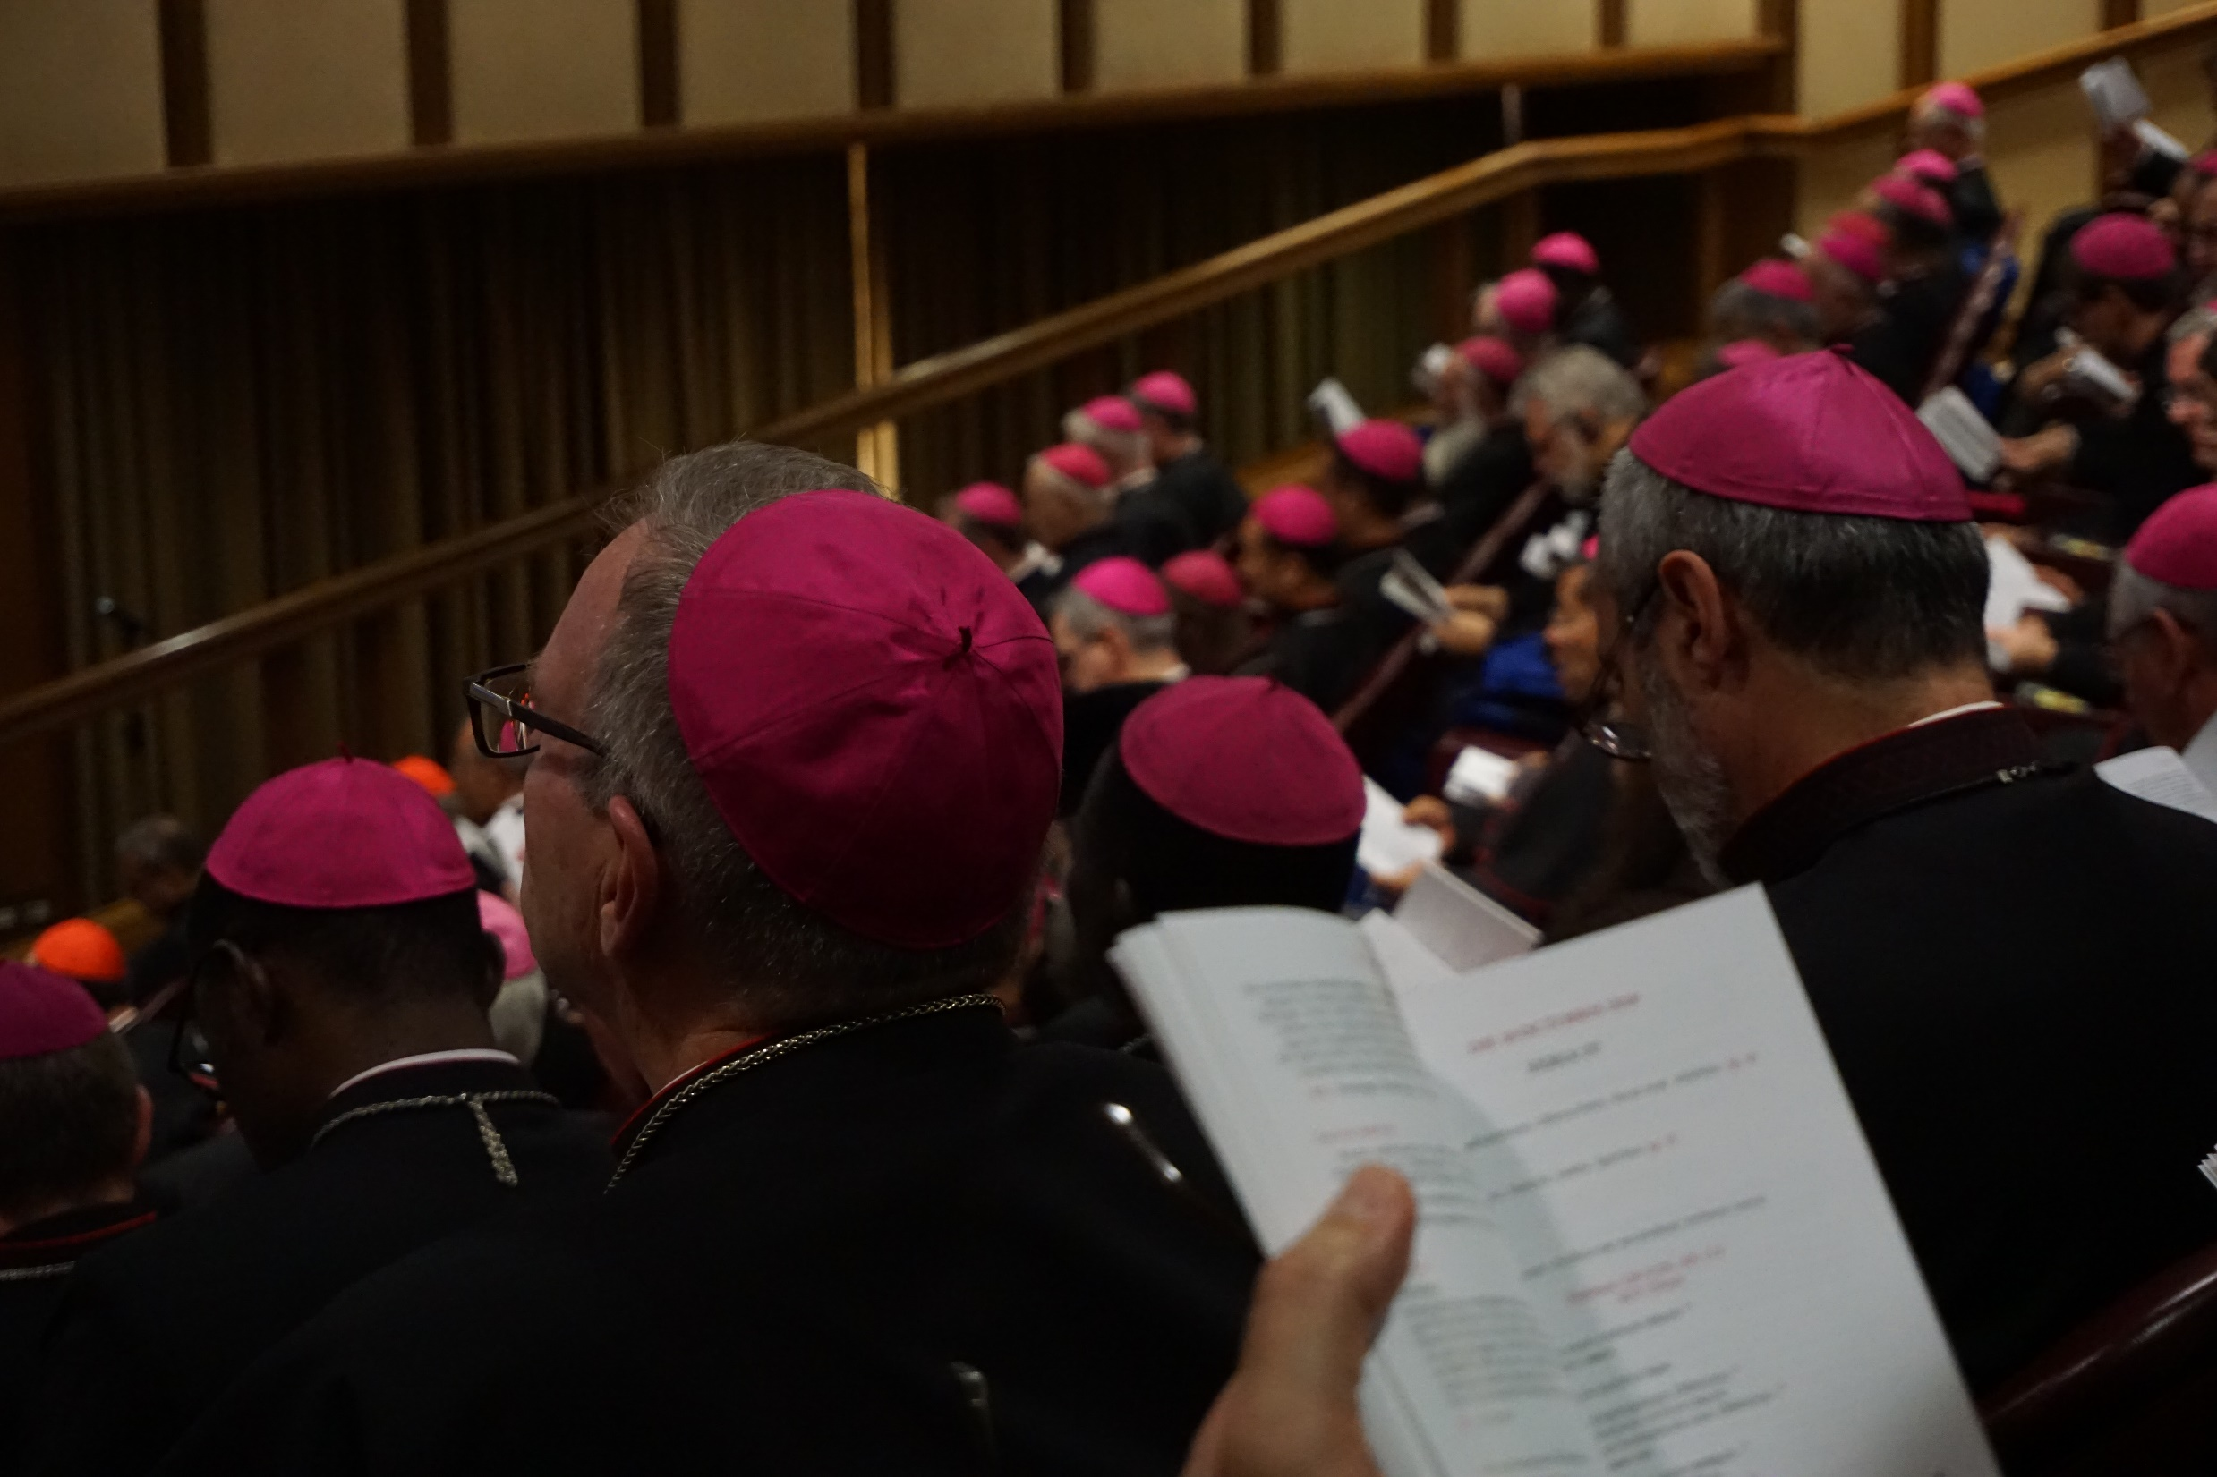

Slide 14
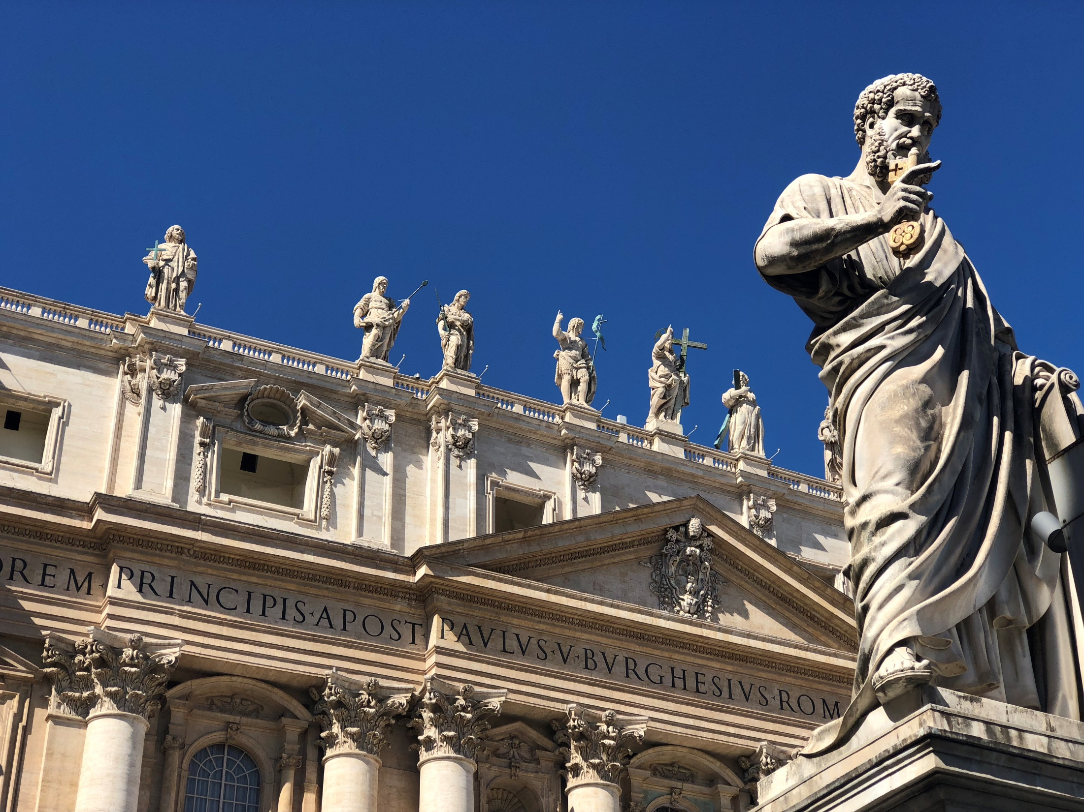

Slide 15
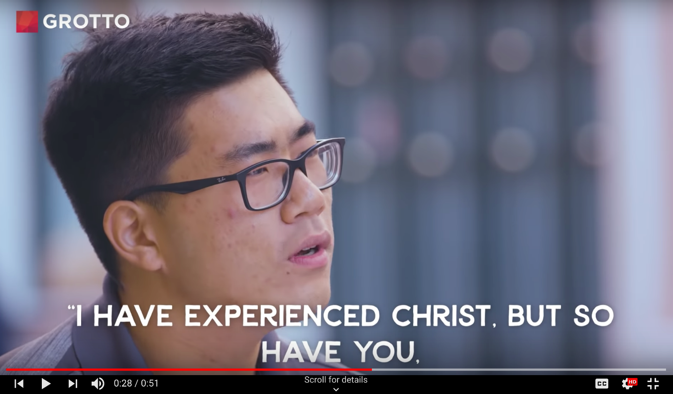
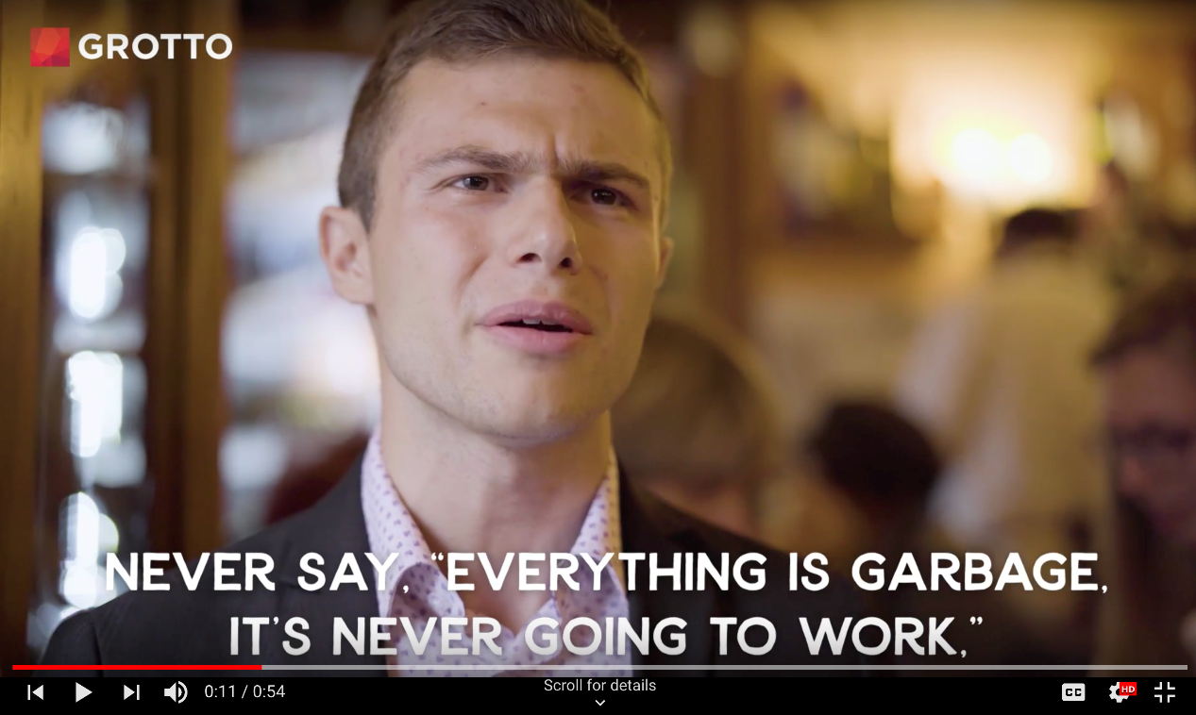

Slide 16
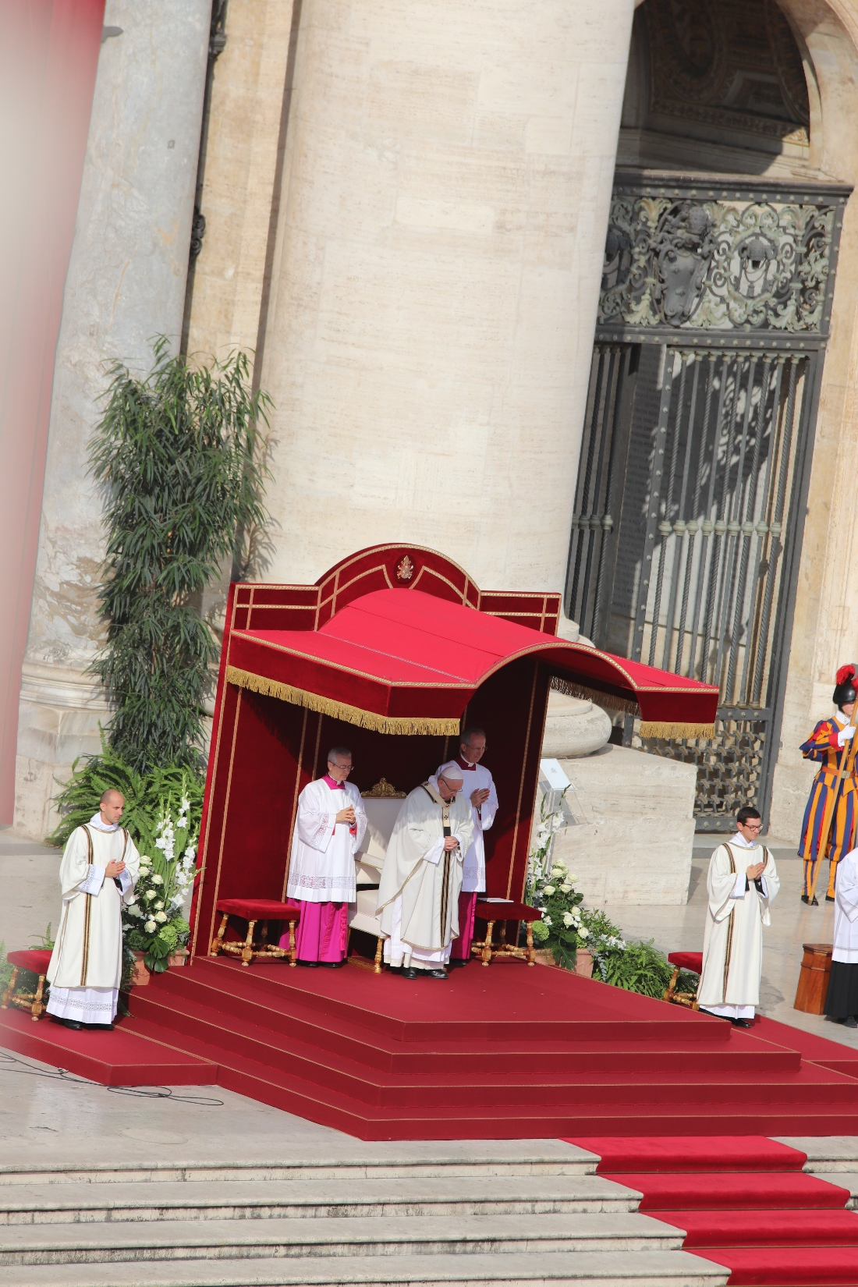

Slide 17
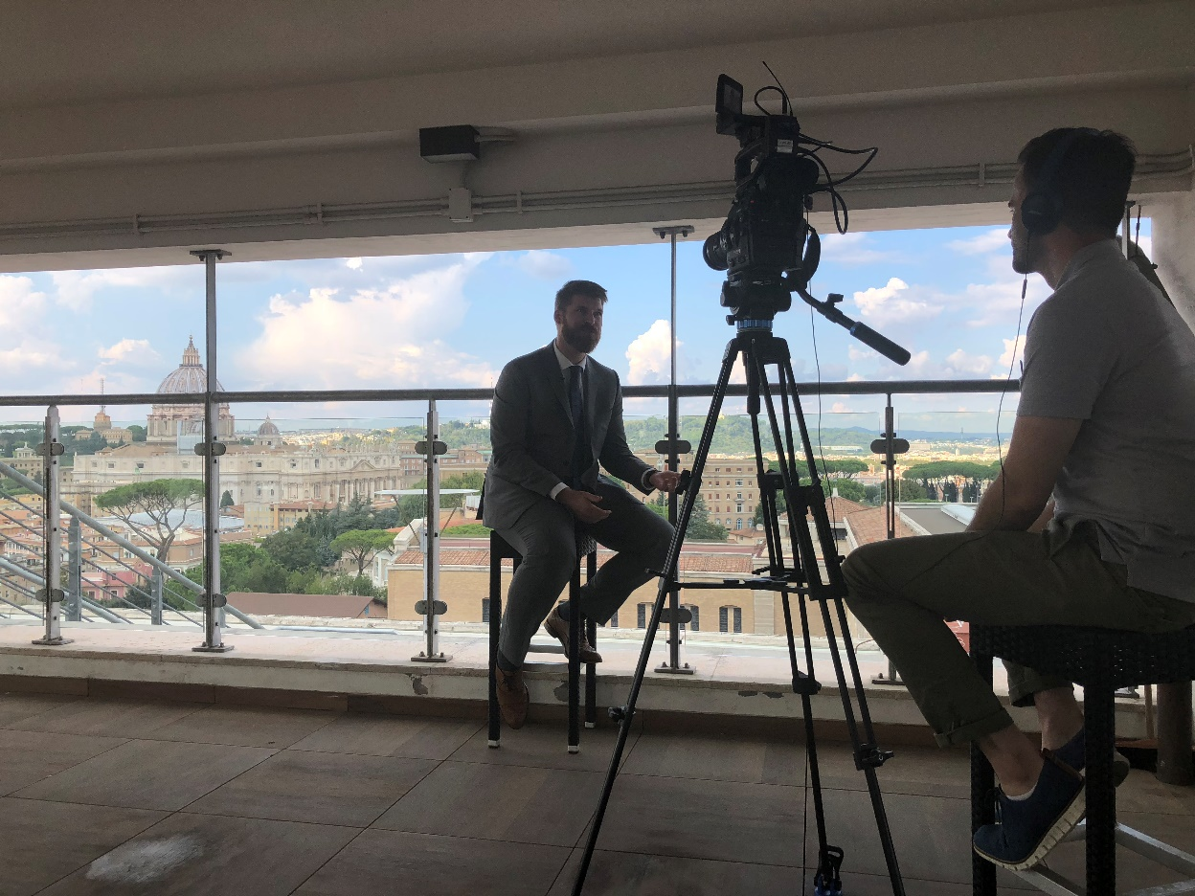
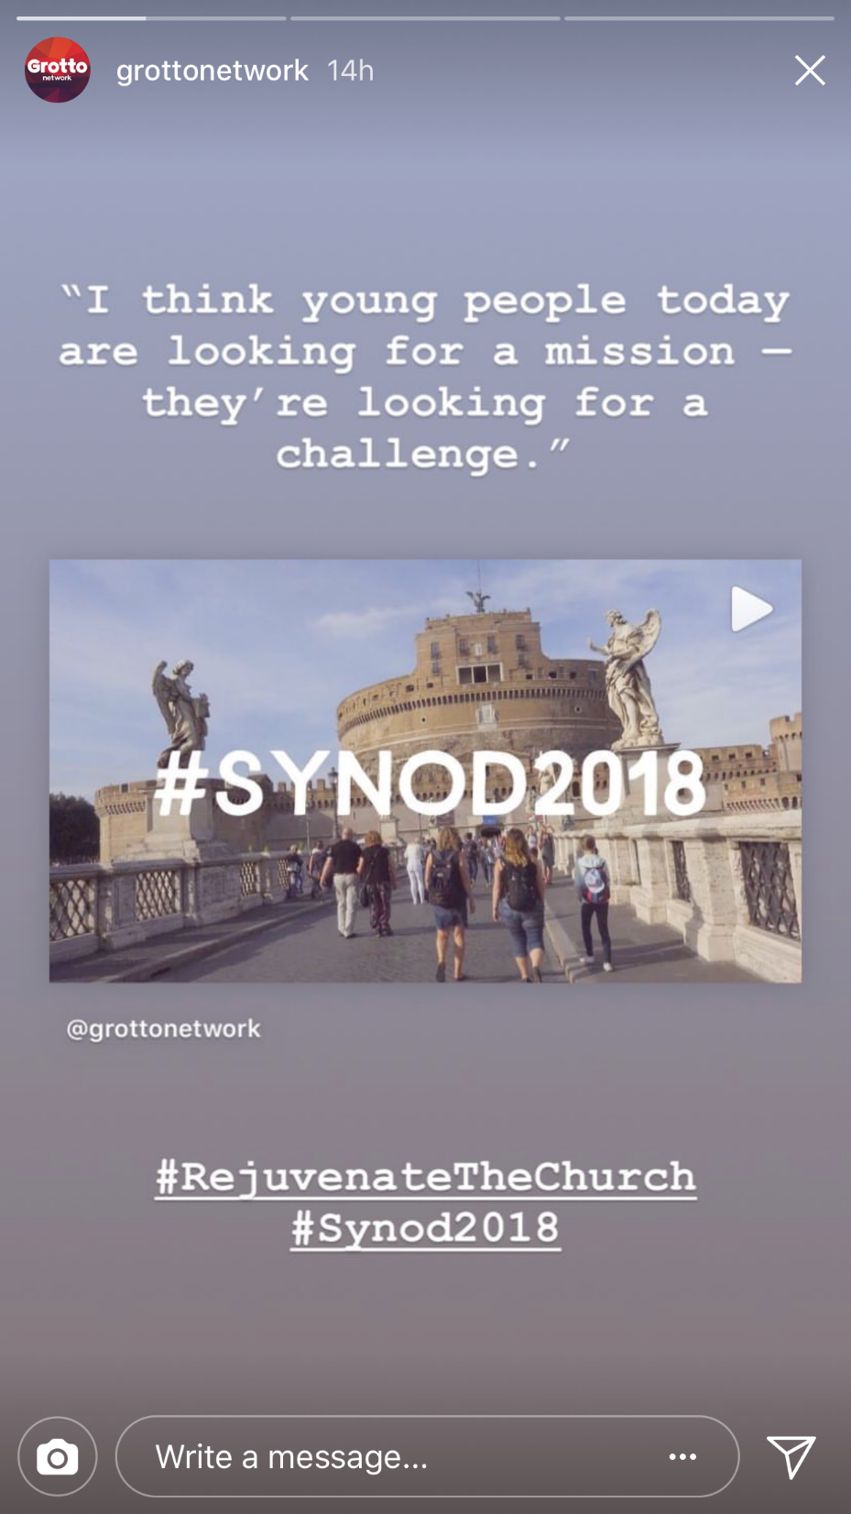
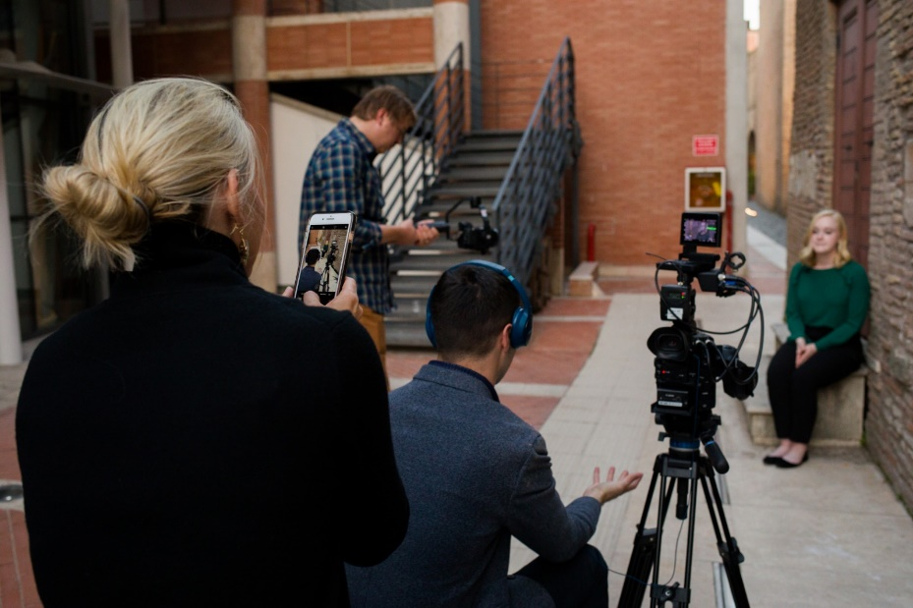

Slide 18
Synod Intervention: How many young people do you know by name?

Slide 19
Relational Authority: Relationships > Institutions
“Modern man [still] listens more willingly to witnesses than to teachers, and if it does listen to teachers it is because they are witnesses” (Pope Saint Paul VI, Evangelii Nuntiandi, 41).
First Task – offer to young people an encounter with Jesus Christ through the witness of each baptized Christian.

Slide 20
Mentorship is Key
Some young people, like my friend Margaret, leave the Church because they no longer trust the Church…Young people are asking for mentors, not who scandalize the Church with sin, but who scandalize the world with holiness.
Some, like my friend Matthew, leave the Church because they have serious questions that have never been answered. Young people are asking for mentors who listen to their questions and provide serious answers that offer a coherent Christian worldview.
Others, like my friend Sam, leave the Church because they find the Church irrelevant. The Church does not speak about their interests and experience. Young people are asking for mentors to befriend them and inculturate the faith into their lives.

Slide 21
Mentorship, the Method of Jesus
Spiritual mentorship was the method of Jesus, the method of the saints, and should be our method today.
In every generation Christ raises up saints who make more saints. Paul helped Timothy, Ignatius helped Francis Xavier, and Louis and Zelie helped Therese.
Still today, the missionary formation of young people must be built on a long-term apprenticeship in Christian living that no textbook or technology can replace.

Slide 22
Examination of Conscience
Churches often ask parishioners about how they are being good stewards of their ‘time, talent, and treasure’. Local churches, too, must start with this examination of conscience:
How many hours do clergy and laity spend each week mentoring young people? Do our Sacramental preparation programs provide long-term spiritual mentorship? Do we invest financially in the formation of lay mentors? How many young people do I know by name?
Saint Oscar Romero said: “you say you love the poor, name them”. I ask you today: “you say you love young people, name them”.

Slide 23
Practical Tips on Spiritual Mentorship
Walk the Road to Emmaus
Start close, not far
Who are the young people in your life you already know by name?
Pray on those names to discern who God is placing on your heart
Think long, not short
The spiritual life is non-linear
Accompaniment is often long term
Go deep, not wide
Start with yourself: expect to offer and to learn
Follow their lead

Slide 24
Mission to Accompany
“Spiritual accompaniment is intended
to help people integrate step by step
the various dimensions of their lives so
as to follow the Lord Jesus.”
-Synod Final Document, 97

Slide 25
Mentoring
Spiritual Mentoring
Catechetical Mentoring
Social Mentoring

Slide 26
Witnessing

Slide 27
Spiritual Friendship

Slide 28
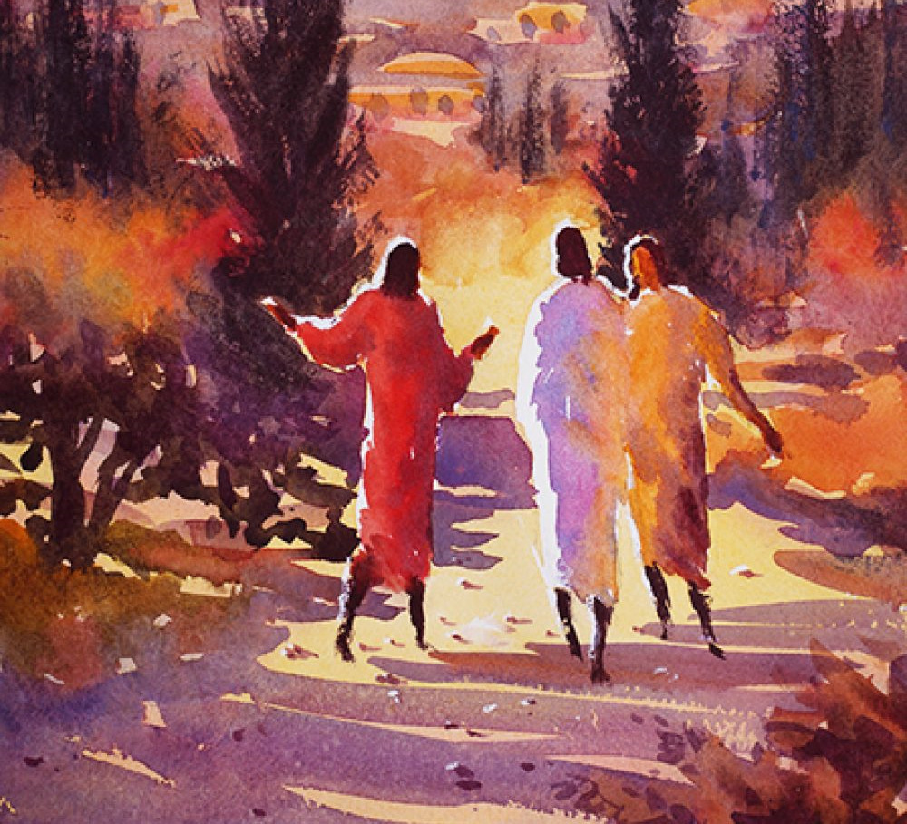
The Art of Accompaniment
Patient Listening
Fearless Healing
Spirit-filled Evangelizing

Slide 29
Accompanier Traits
Balanced
Listener
Person of faith and prayer
Knows own weaknesses
and frailties

Slide 30
Time for Questions & Dialogue

Slide 31
Additional Resources
www.catholicapostolatecenter.org

